Slide 1
Module 9 Tribology and Lubrication
Dr. Belle R. Upadhyaya
Seyed A. Niknam
College of Engineering
Nuclear Engineering Department
The University of Tennessee
© 2014

Slide 2
Outline
Terminology
Introduction to Tribology
Introduction to Oil Analysis
Overview of Lubricants
Machine Failures
Lubricating Oil Analysis
Lubrication Program
Oil Sampling
Grease

Slide 3
Terminology
Tribology: science and technology of interacting surfaces in relative motion
Metrology: science and technology of measurement
Surface Roughness: asperities with varying amplitude and spacing
Viscosity: resistance to flow
Rheology: study of the flow of matter

Slide 4
Introduction to Tribology
Tribology: is about friction, wear and lubrication
Focus: measuring and modeling the origins of friction and wear
Tribo-features of a system: surface, endurance of lubricants, coatings, self-lubricating materials, etc.
Tribology techniques can be used for predictive maintenance and to enhance maintainability.
Major limitations with using tribology analysis:
Equipment costs
Appropriate oil samples
Interpretation of data

Slide 5
Surface
Constituent parts of a manufactured surface:
Topography (external feature): essential for the study of tribological behavior of interacting surface
Metallurgy, mechanical properties, chemistry (internal features)
Effects of the manufacturing process:
Turned surface:
Regular cusp
Highly anisotropic surface texture
EDM surface:
Regular cusp
Isotropic surface texture

Slide 6
Introduction to Oil Analysis
What is oil analysis?
Similar to blood test
Oil analysis can/should
Indicate health, predict life
Classify the root cause and severity of wear problems
Diagnose the cause of fluid degradation
Confirm the maintenance actions and policies
Maximize machinery performance and availability
Life extension

Slide 7
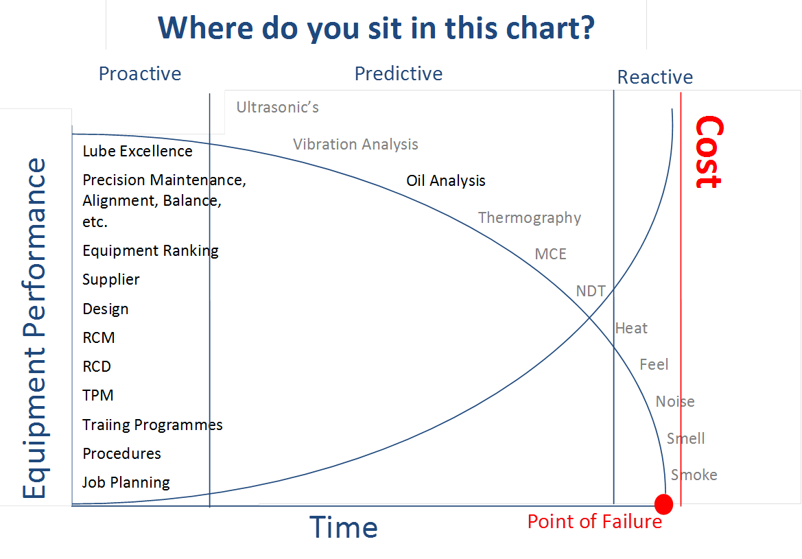
Introduction to Oil Analysis

Slide 8
Overview of Lubricants
Paraffinic: Most frequently used for industrial lubricants
Napthinic: Compressors & Cutting fluids
PAO Polyalphaolefin
SHC synthetic hydrocarbon
Most common synthetic oil (It is not mineral oil)
Crankcase oils
PhE Phosphate Ester: Fire retardant hydraulic
PAG Polyalkylene Glycol: High temperature service
POE Polyol Ester: High temperature service
PFE Perfluorinated Ether: Ultra-low volatility

Slide 9
Additive | Purpose | How it works
Antioxidant | Minimizes resins, varnish, acids, sludge, polymers | Reduces organic peroxides, terminates oxidation chain
Corrosion inhibitor | Protects metal surfaces from corrosion | Coat metal surfaces and protects against acids, oxygen, and water
Anti-wear | Reduces wear from metal-to-metal contact (boundary) | Reacts with metal to form new compound deformed by plastic flow
Viscosity Improver (VI) | Reduce rate of change of viscosity with temperature | Polymer changes shape to increase high temperature viscosity
Anti-foam | Prevents formation of stable foam | Reduces interfacial tension between oil and air
Emulsifier | Makes mineral oil water miscible | Reduces interfacial tension between oil and water

Slide 10
Machine Failures
Accidents & Obsolescence
Surface degradation:
Corrosion: Results of water contamination. Results in rust and other forms of oxidation
Wear:
Abrasion: Results of dirt in the oil.
Fatigue: Long term rolling contact.
Adhesion: caused by inadequate lubrication. Result in metal to metal dragging: generates a lot of debris, ultrasonic sound energy, and produces heat

Slide 11
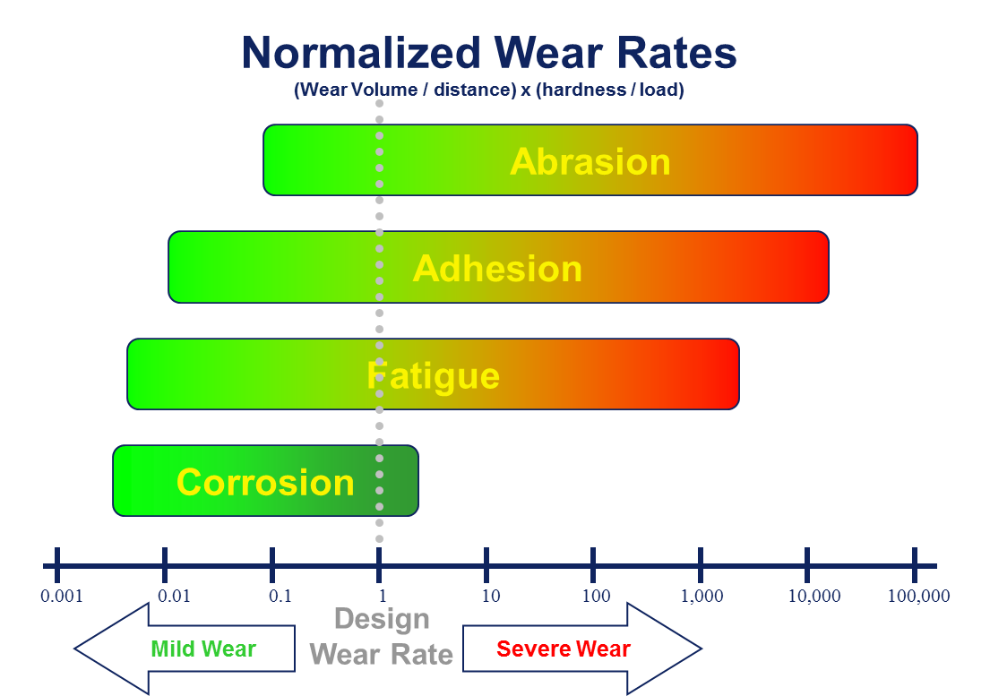
Machine Failures
R.G. Bayer, Wear Analysis for Engineers, HNB Publishing, 2001

Slide 12
Machine Failures
Lubricants need to be:
Clean (no abrasive particles)
Dry (no corrosive fluids)
Fit for use (quality lubricant in proper amount)
Machines should experience “mild wear” mechanisms (long machine life)
Ultra-fine “mild wear” is both unavoidable and normal.
Severe wear mechanisms should be stopped
Large particle is avoidable and undesirable

Slide 13
Abrasion
Often, the most aggressive abnormal wear mechanism.
Cause: hard particles (e.g. silicon particles) that get imbedded into the soft surface as they become trapped between moving surfaces.
Abrasion depends on three key factors:
Threshold particle size: If the particles are larger than the clearance, they get stuck and do damage.
Threshold hardness: If the particles are harder than the surfaces then they will cut.
Concentration of debris in the oil (Silica dust in oil)
Extremely abrasive, so one needs to control the contamination in lubrication systems.

Slide 14
Adhesion
Main cause: inadequate lubrication
No oil or low oil level
Low Viscosity: wrong oil, high temperature, dilution, water contamination
High load and/or slow speed
Common with sliding, metal-to-metal contact
Sliding occurs in journals, thrust plates, and above and below the pitch-line on gears.
Metal-to-metal friction causes high temperature
Particles: melted, smeared and discolored
Monitoring: thermography, wear particle analysis, and ultrasonic analysis.

Slide 15
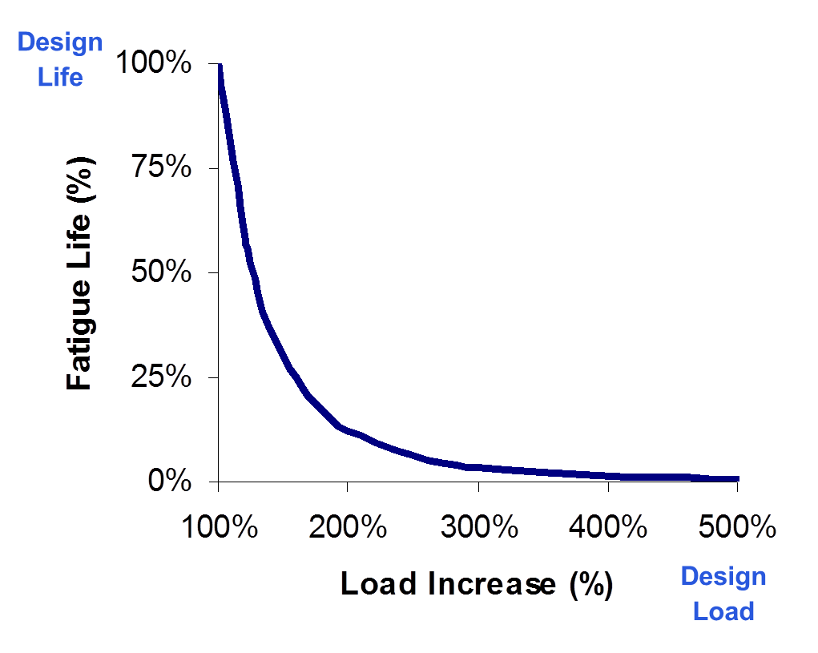
Fatigue Life

Slide 16
Lubricating Oil Analysis
 | Wear | Contamination | Chemistry
Engine | Fe, Pb, Sn, Cu wear is mostly oxide and mostly <5 micron size. Concentration in direct proportion to soot and oxidation and inversely proportional to TBN. Steady increase in wear concentration between oil changes. | Soot, dust, and coolant contamination. | Combustion gases consume TBN, contaminants consume detergent additives, hot surfaces oxidize oil.
Hydraulic | Any wear is an abnormal condition. Abrasive wear results from dust and corrosive wear from moisture. Seal wear from contamination or fit. | Dust, water, and air contamination. | High temperatures oxidize oil and produce acidity.
Transformer | Wear due to arcing generates dissolved gases in oil. | Water contamination. | Prolonged arcing, moisture, and heat may oxidize oil.
Gear and Roller Bearing | Abrasion, fatigue, and adhesion generate ferrous wear debris 10 to 100 micron. Size increases with severity. | Dust, water, and wear debris. | Moisture, heat, and air entrainment may oxidize oil.
Journal | Negligible wear except from rub which generates 0 to 50 micron Pb, Sn, Sb, Cu, and Fe. Abrasion generates Fe due to dust imbedding into soft journal. | Dust, water, and process contamination. | Moisture and heat may oxidize oil.

Slide 17
Lubricating Oil Analysis
Commonly performed oil analysis tests:
Viscosity
Low viscosity oil film will increase the likelihood of metal-to-metal contact.
High viscosity oil film will fail to lubricate properly and flow to vital locations.
Contamination
Water
Fuel dilution:
Weakens the oil film strength
Caused by improper operation, fuel system leaks, ignition problems, improper timing, etc.
Excessive level: 2.5-5 %

Slide 18
Lubricating Oil Analysis
Commonly performed oil analysis tests:
Oxidation:
Can be the cause of metal corrosion
Although most lubricants have oxidation inhibitors, oxidation of oil begins due to the consumption of the additives.
Nitration due to combustion will accelerate oil oxidation.
Rotating Pressure Vessel Oxidation Test (RPVOT)
Total acid number
Total base number(TBN)
Specify the neutralize acidity
Typical causes of low TBN include using the improper oil, long interval for oil changes, and overheating.

Slide 19
Lubricating Oil Analysis
Commonly performed oil analysis tests:
Fuel soot: an important indicator for the fuel burning efficiency in diesel engines
Particle count:
Indication of abnormal wear and blocked orifices
A common test for hydraulic systems
Dielectric: electrical insulating properties
Ferrography: Use magnetic field
Limited to ferrous or magnetic particles
Contamination larger than 10 microns (up to 100)
Solids content: cause of wear

Slide 20
Spectrometric Oil Analysis
Accurate and rapid measurements of the elemental composition especially metals (e.g. wear metals).
The oil sample needs to be burned. During the burn the spectrum of light emitted indicates the metal elements in the oil.
Major limitation: size of measured particles 3-8 microns (not good enough for wear monitoring)
Test of Additives: Zn, P, Ca, Mg
Use this to detect wrong or mixed oils
Detect certain contaminants (e.g. Na and B indicate possible coolant leak)
Si (<5 micron) may be dust
Detect wear metals smaller than 5 microns
Fe, Cu, Sn, Pb

Slide 21
Lubricating Oil Analysis
Commonly performed oil analysis tests:
Wear particle/debris analysis:
Through a sample of lubricating oil
Particle shape, composition, size and quantity
Monitoring and trending of the particles over time
Analysis of several samples
Five basic types of wear: rubbing , cutting, rolling fatigue (e.g. bearings), combined rolling and sliding wear (gear systems), and severe sliding wear
Three particle types in rolling fatigue mechanisms: fatigue spall particle, spherical particles, and laminar particles
The size of particles in rubbing wear and early rolling fatigue mechanisms is less than 15microns.

Slide 22
Contamination Of Oils
Particle count
Particle size distribution
ppm < 6 micron
ppm 6 to 14 micron
ppm >14 micron
Water-in-oil
Glycol (engine)
Soot (diesel engine)
Spectrometals: Sodium (Na); Boron (B); Silicon (Si) < 5 micron

Slide 23
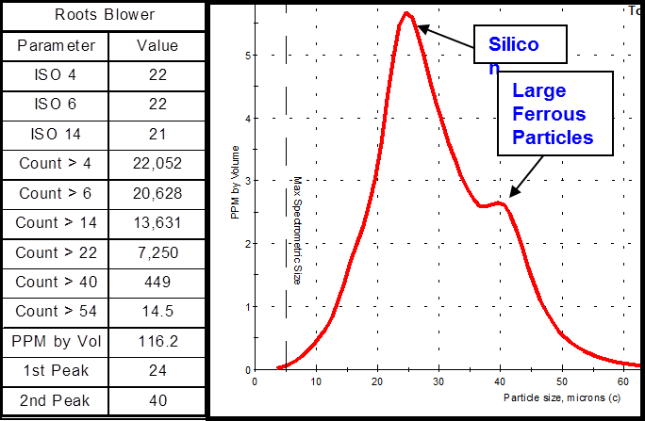
Contamination Control
Establish and maintain target cleanliness levels
Dust contamination
Process contamination
Water-in-oil
ISO code & % Water
“ppm”: parts per million by weight.

Slide 24
Contamination Control
Steps to implementing contamination control
Keep out
Incoming oil
Breather, cover, seals
Secondary wear
Filter out
Circulating
Off-line
Drain out
Bleed off bottom
Oil change
Measure Contamination: Set target cleanliness

Slide 25
Contamination Control
PPM w/w = Weight of one part divided by weight of whole (x 10^6)
Spectrometers report ppm w/w.
A spectrometer only measures the ultra-fine particulate debris (> 5 microns), so we miss Fe, Cu, Pb, Sn, and Si particles
PPM v/v = volume of one part (e.g. particles) divided by volume of whole (e.g. oil) (x 10^6)
Optical particle counters directly measure the shadow area of individual particles. The “size” reported is the diameter of a circle with same area.

Slide 26
Contamination Control

Slide 27
Lubrication program
Selection and specification (Inventory management)
Service life of lubricant >> Service life of system
Supply: on-site tests for validation (dielectric and viscosity, cleanliness moisture codes)
Storage & Filtering
Inadequate lubrication:.
No oil or low oil level
Low Viscosity: Wrong oil, high temperature, dilution, water contamination
Slow speed or high load: static & dynamic
Off-site lab & on-site minilab analysis

Slide 28
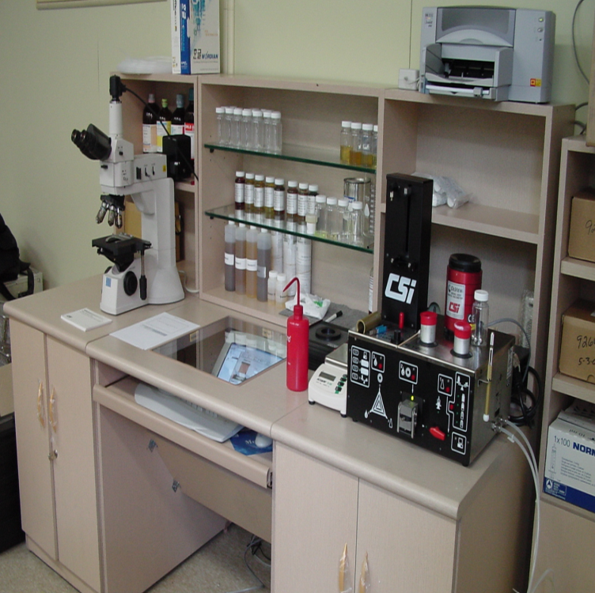
Oil Minilab
Typical cost per sample is $6 to $50 per sample depending on sample volume.
5200 Trivector Analyzer:
Test 1: Dielectric of the oil sample
Test 2: Measures the water and ferrous content
Test 3: Laser particle counter to look for particulate contamination and particle size distribution
Test 4: Filter patch to trap particles for detailed wear debris analysis
Comprehensive oil analysis in about 7 minutes per sample: the combination of the above-mentioned tests and viscosity test

Slide 29
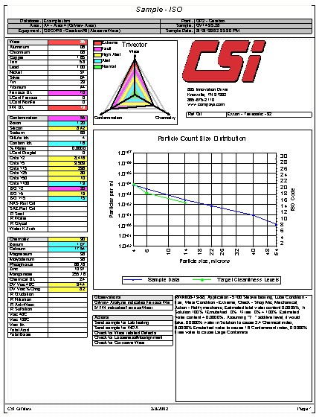
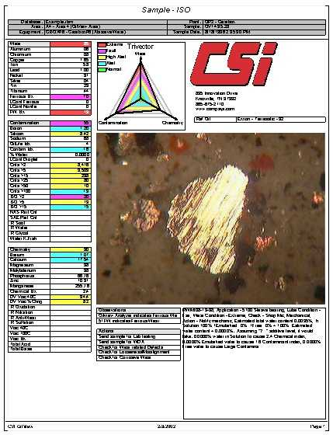

Slide 30
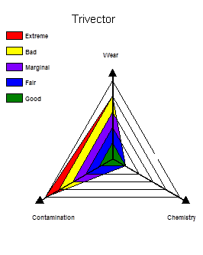
Trivector diagram
Easy to interpret
Classify the measured parameters into one of there categories: wear, contamination, or chemistry.
Wear: ferrous and non-ferrous metals.
Contamination: dust, water and process material in oil.
Chemistry: measures of oil quality and additive characteristics.
Each vector has five levels.
Lowest level: normal; Second level: change noted but still okay; Third level is warning. Fourth level is where action of some sort should be taken. Fifth level is extreme, action should have been taken already.

Slide 31
Oil Sampling
Full benefit of oil analysis
Continuous monitoring?
Taking frequent samples
Properly collected oil sample
Collected from an “active zone”.
Sample points that are likely to contain large particles
Oil is agitated and well mixed.
Not a long time after the shut down
Cold oil has a very high viscosity
Under uniform operating conditions
Before the filtration
From the reservoir oil?

Slide 32
Oil Sampling
Sampling frequency
Function of MTTF/MTBF
Oil type
Oil age or actual condition
Frequency of extreme situations: high-speed, high loads and shock loads
Environmental stress (e.g. heat, moisture)
Importance of the incipient fault
Trend and amount of contaminants

Slide 33
Grease
Grease is a lubricant with high initial viscosity (fluid lubricant + thickener+ additives)
Objectives of using grease:
Remain in contact with moving surfaces and minimize leakage and contamination
Retain properties even under stress
Extend the life of worn components
Problems: over-greasing, under-greasing, mixed greases, or no grease
Result of grease problem: under lubricated system

Slide 34
Standards
ISO 4406: Cleanliness Level Code -
Cleanliness goal should be specified for all the oil-filled systems
ISO 11500:2008: An automatic particle-counting procedure
ISO 212:2007: Sampling
ISO 356:1996: Preparation of test samples
ISO 1242:1999: Determination of acid value
ASTM D6224: In-service monitoring of lubricating oil for auxiliary power plant equipment

Slide 35
Summary
Specify and understand tribo-features of the system.
Oil analysis is based on equipment, the test performed, and the guidelines for alarms (e.g. number of counts)
Over 1600 oil analysis: size, shape and composition of particles
Lubrication program is an important aspect of asset health management and needs to focus on mechanisms that cause most of the critical failures.
Oil sampling needs to be carefully designed.
Improvement in maintainability = improvement in the length of oil change or replenishment interval

Slide 36
References
R. Garvey, The Lubrication Aspect of Machinery Health Management, Emerson Process Management
R.G. Bayer, Wear Analysis for Engineers, HNB Publishing, 2001
Z.M. Jin, M. Stone, E. Ingham, J. Fisher, (v) Biotribology, Current Orthopaedics, 2006, 20:1, 32-40
R. Keith Mobley, Plant Engineer's Handbook, Butterworth-Heinemann, 2001
M.F. Wania, O.P. Gandhib, Maintainability design and evaluation of mechanical systems based on tribology, Reliability Engineering & System Safety, 2002, 77:2, 181–188

Slide 37
Additional References
Paulo Davim (editor), Tribology for engineers, Woodhead Publishing, Cambridge, 2011
Ernest Rabinowicz, Friction and Wear of Materials, Wiley, 1995, 2nd Edition
Society of Tribologists and Lubrication Engineers
www.machinerylubrication.com

